Slide 1
자바기본프로그래밍 3강
Kopo30 이동현

Slide 2
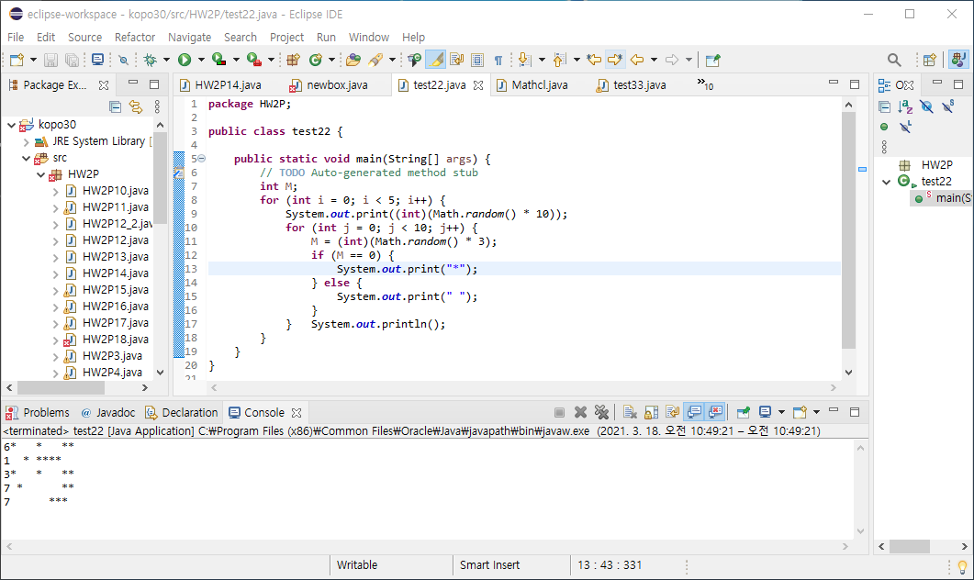
3일차 test1

Slide 3
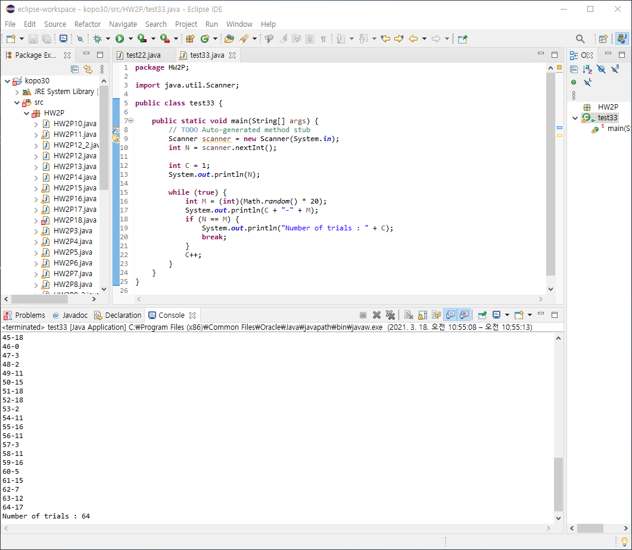
3일차 test2

Slide 4
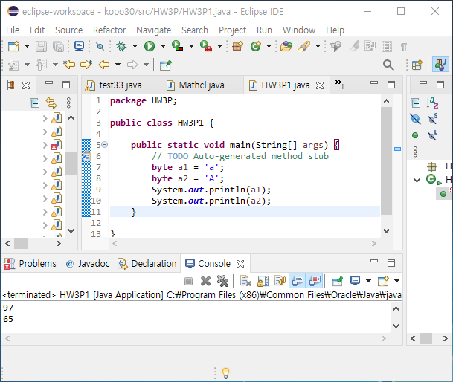
P1 : Converting Character to ASCII Code

Slide 5
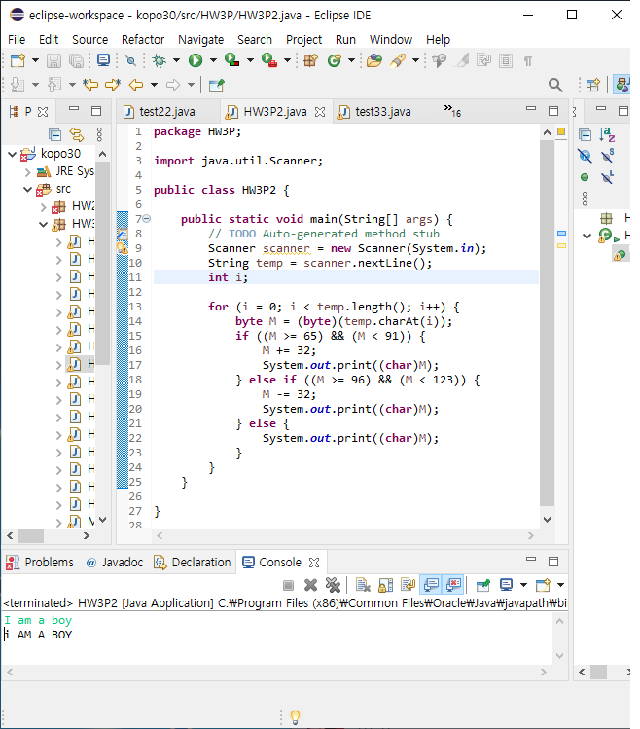
P2 : Converting Characters to Opposite Case

Slide 6
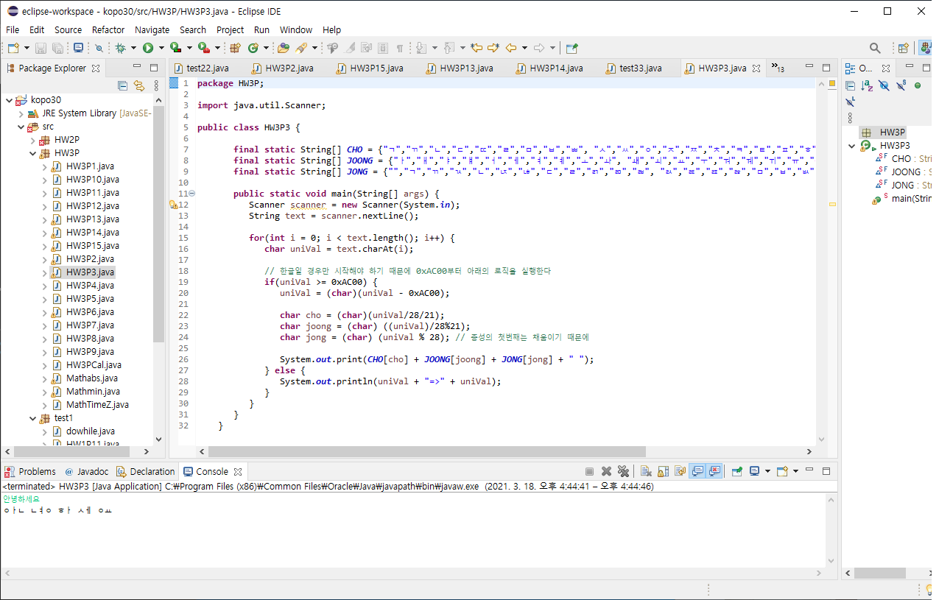
P3 : Split Korean Characters into “First”, “Neutral” and “Final” Characters

Slide 7
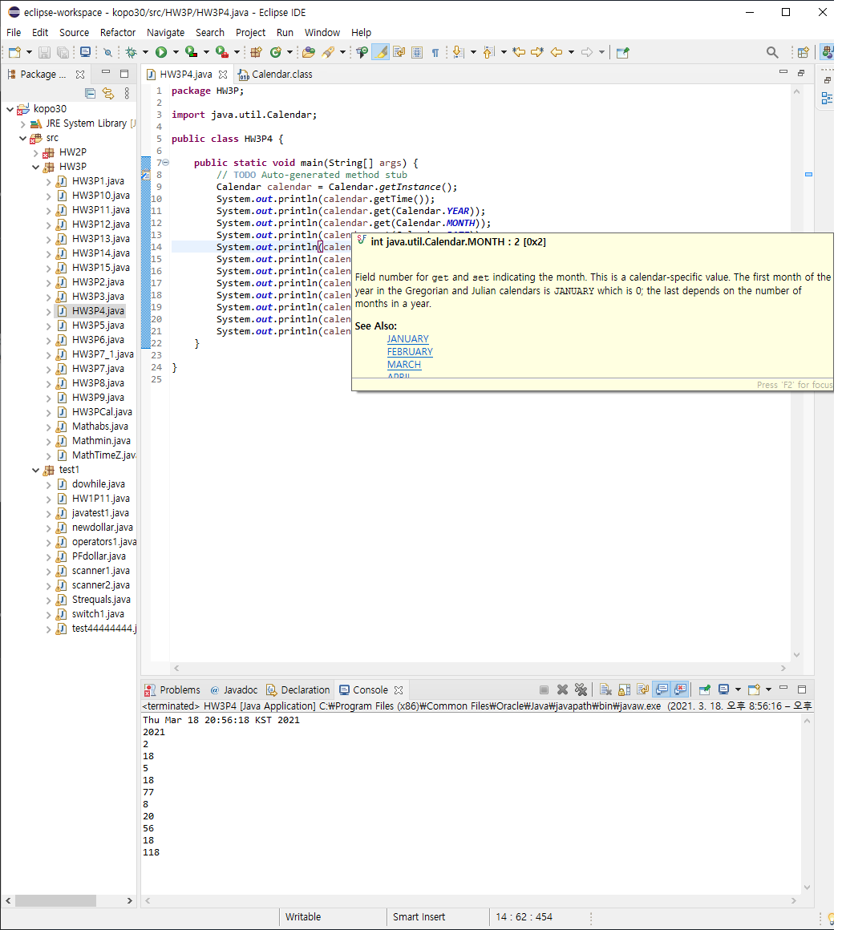
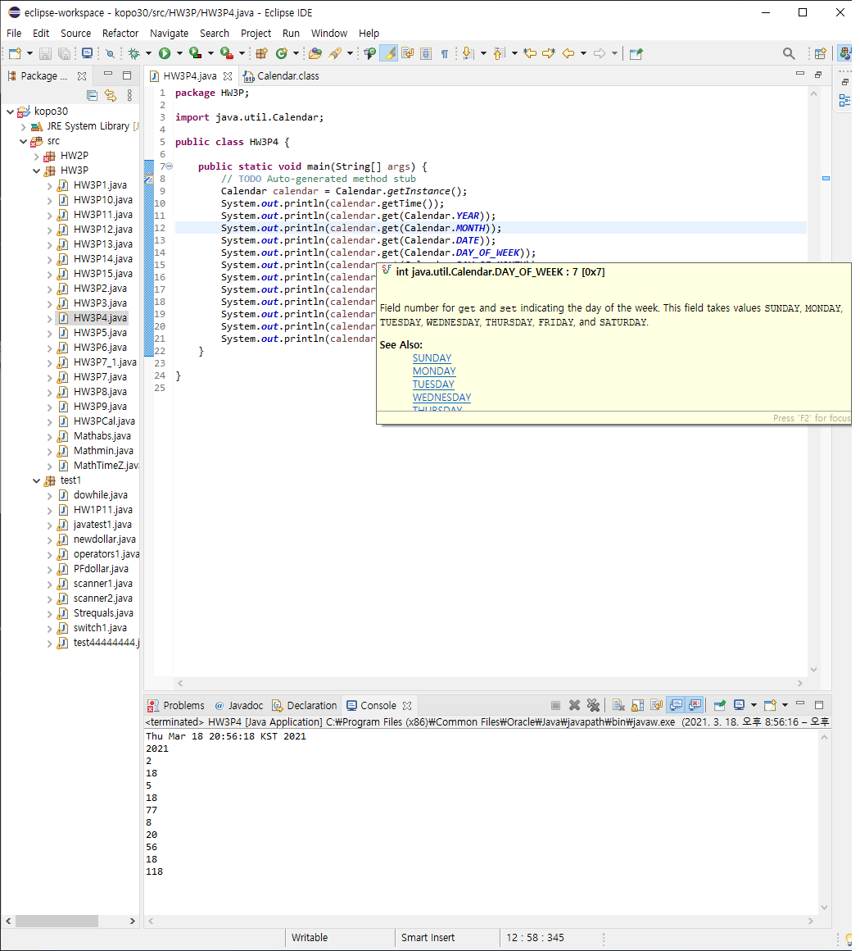
P4 : Find out the range of the return values
월은 시작이 0부터 시작이기 때문에 2가 3월이 되었고
일요일이 1부터 시작해서 목요일이라 5이다.

Slide 8
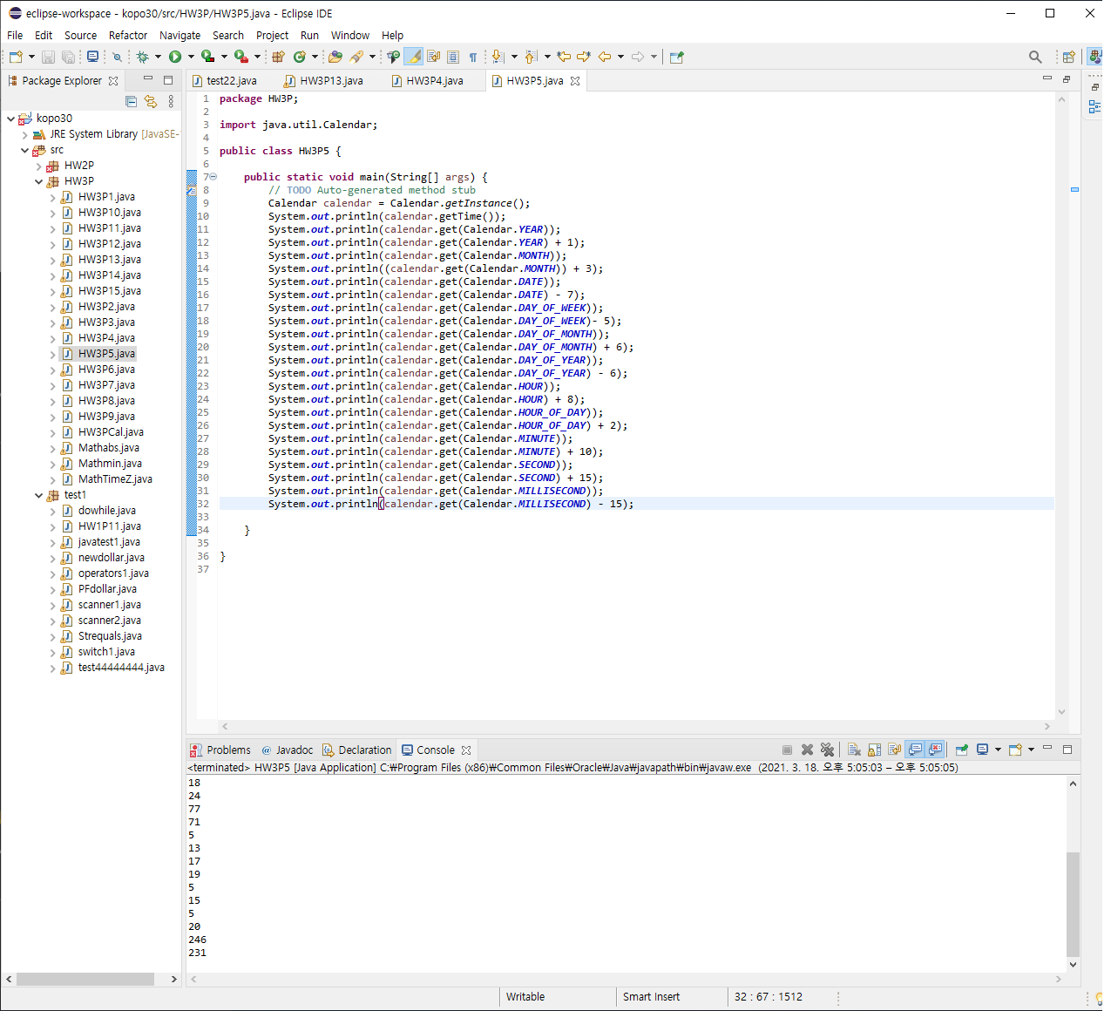
P5 : Try this with the other parameters such as Calendar.Hour

Slide 9
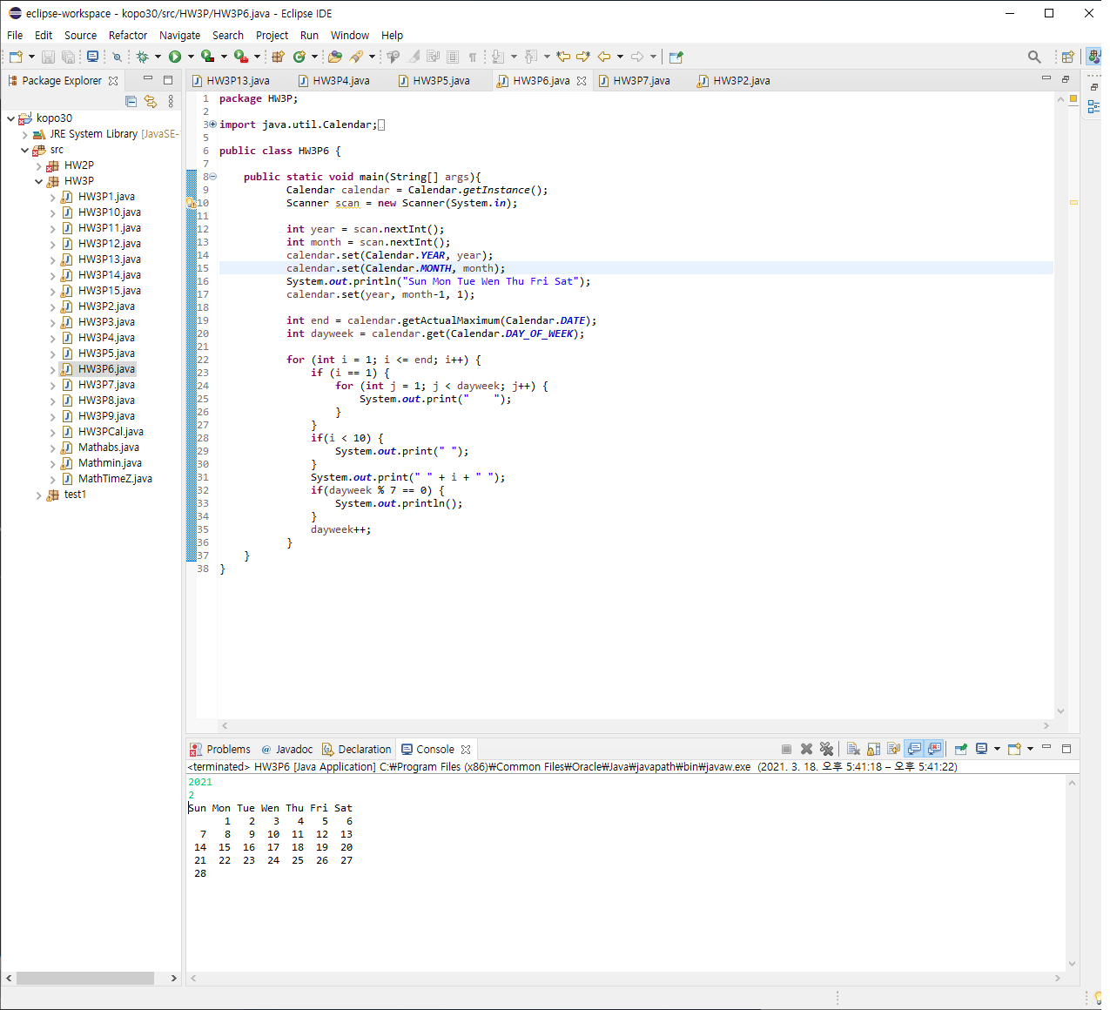
P6 : Calendar Application

Slide 10
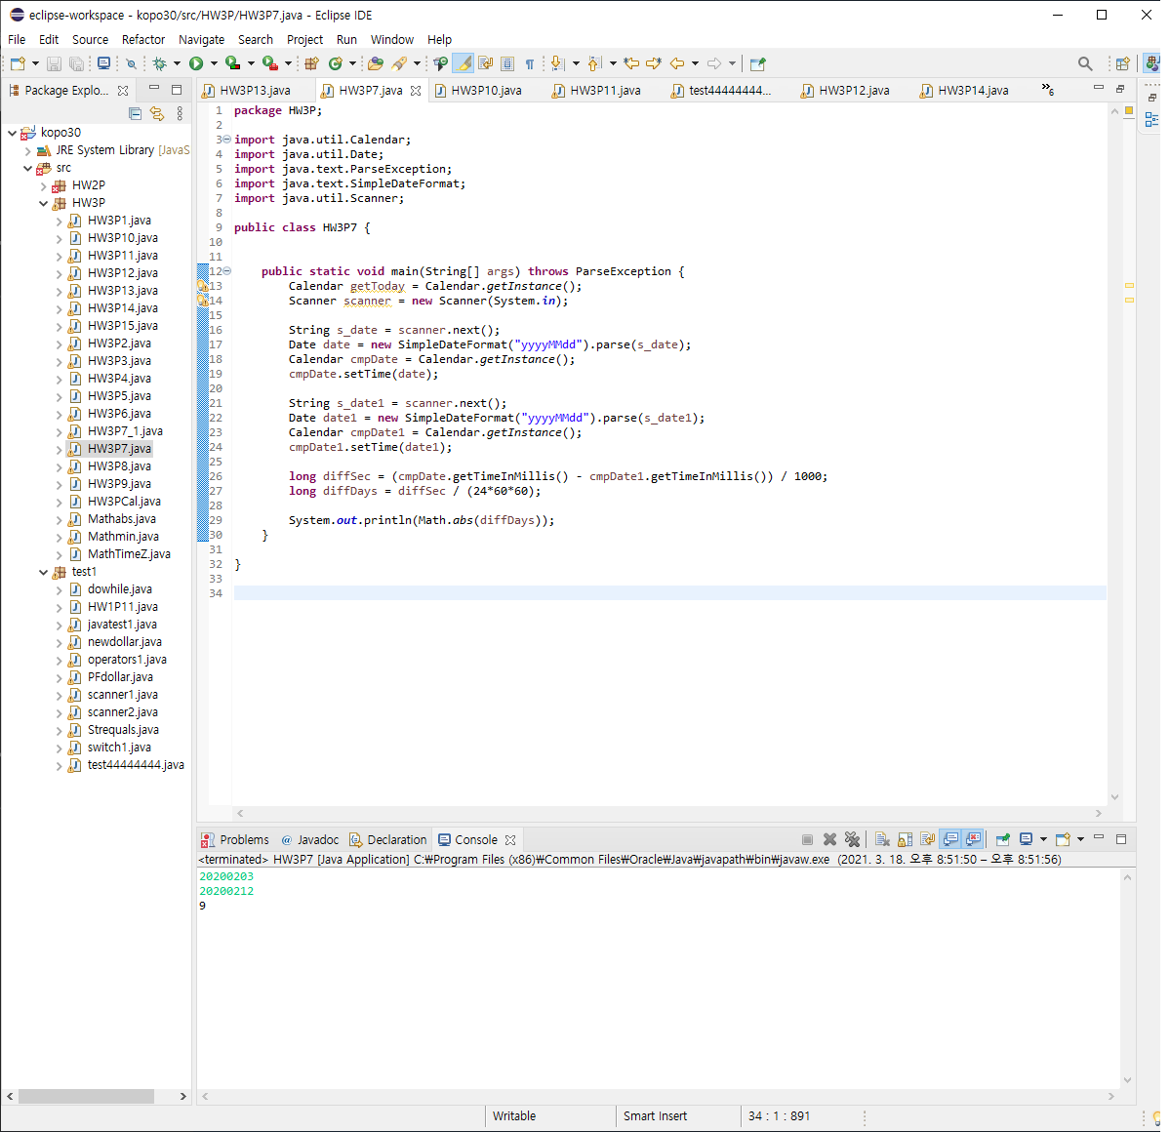
P7: Calendar Application 2

Slide 11
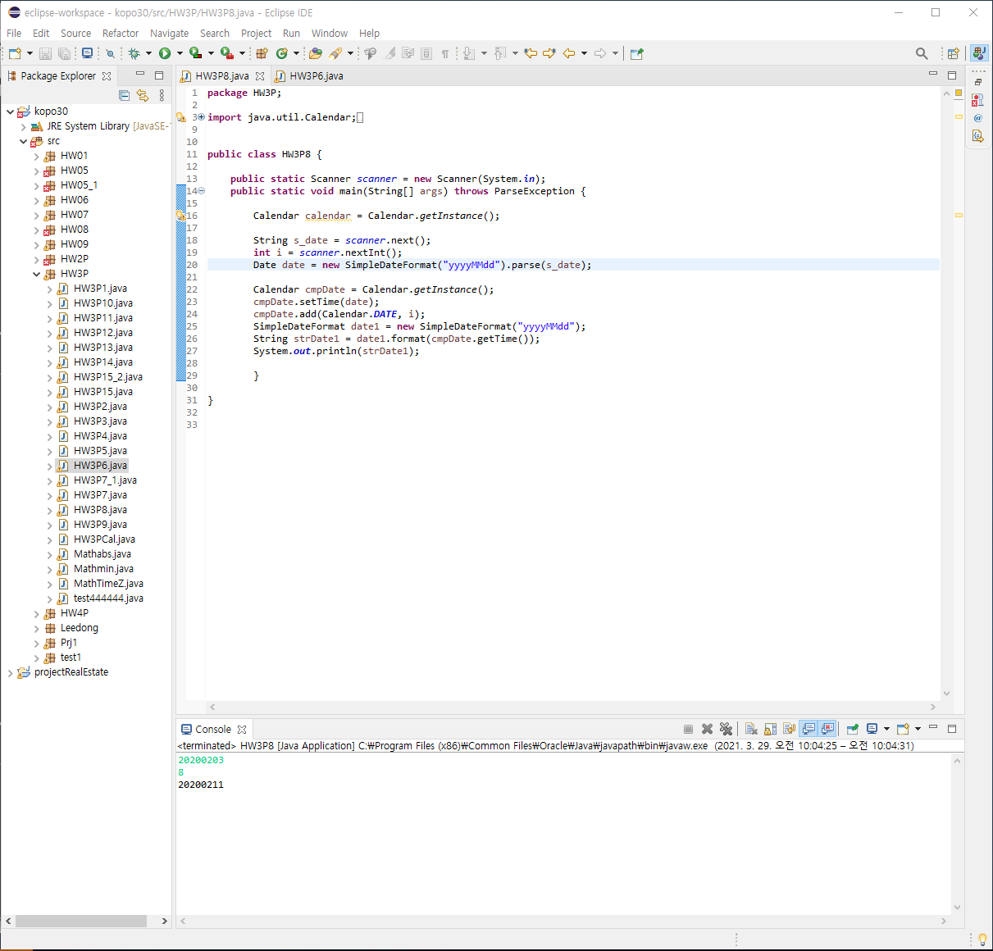
P8: Calendar Application 3

Slide 12
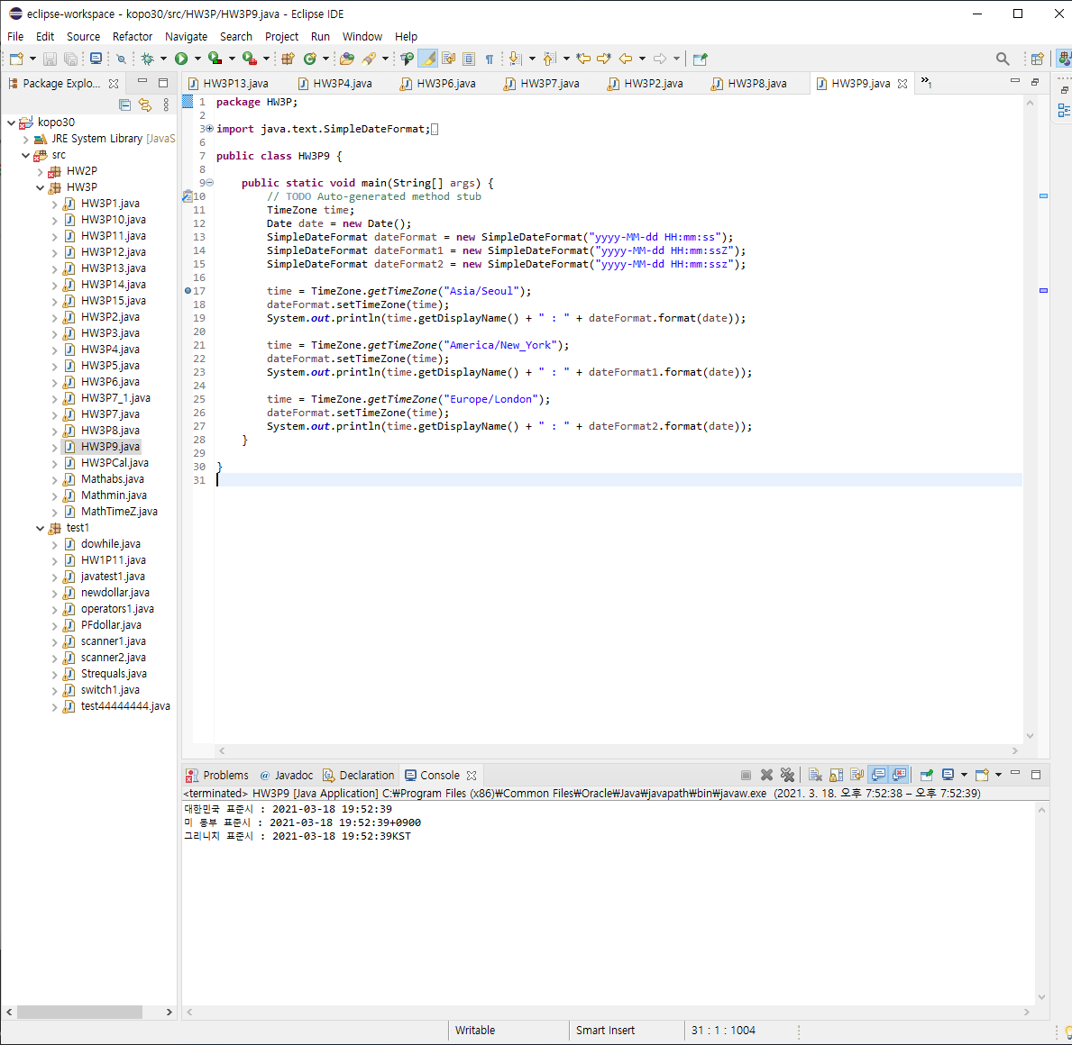
P9: add “z Z” at the end of dateFormat and print the time again

Slide 13
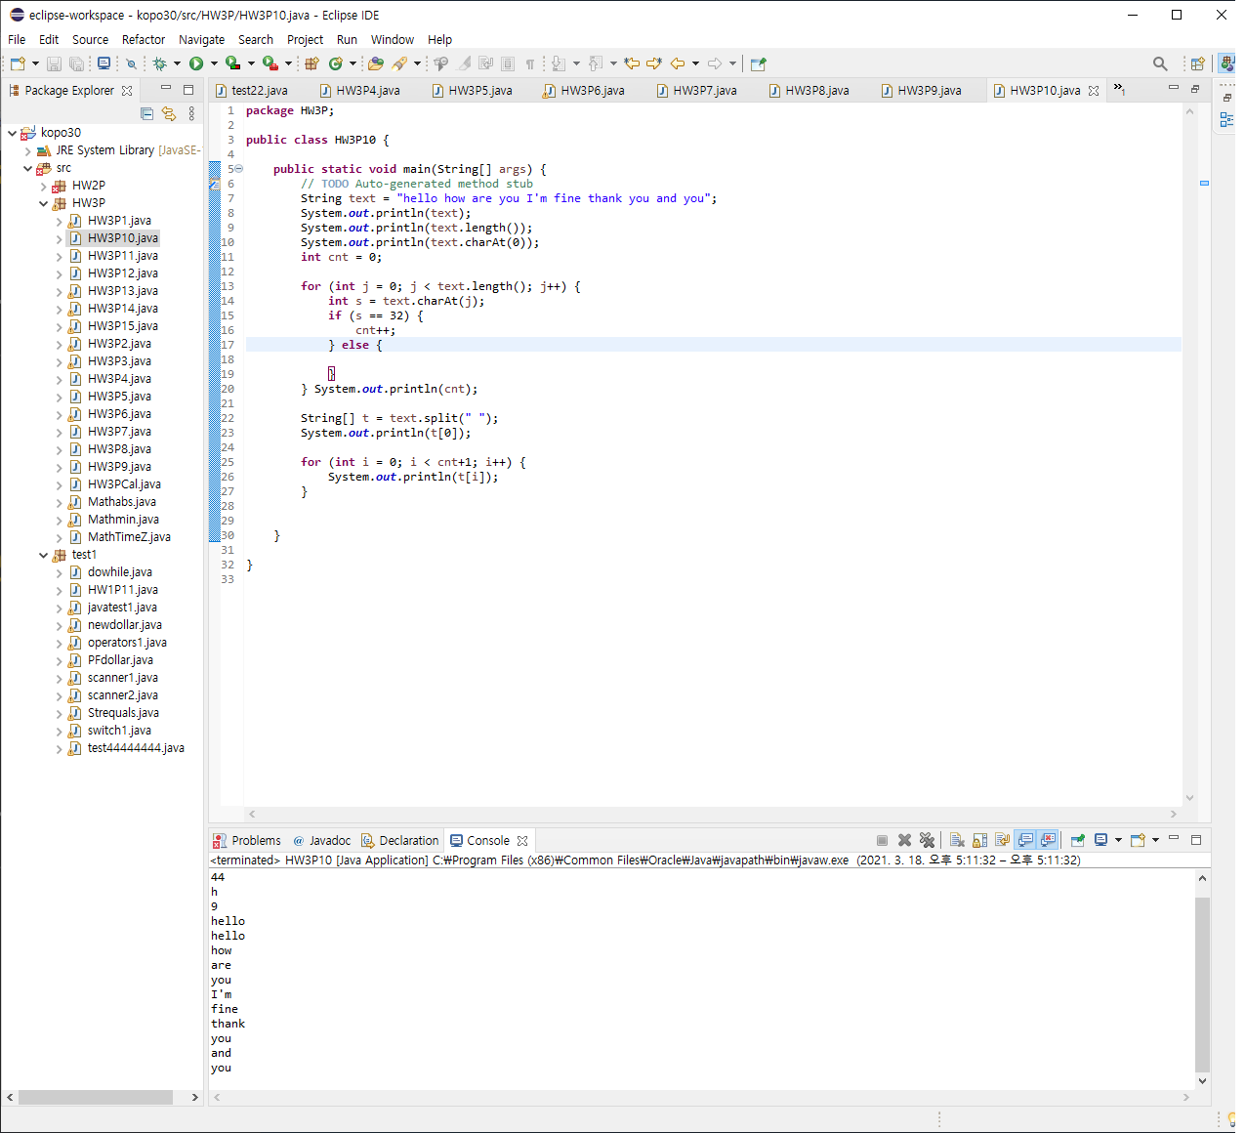
P10 : Explain the reason why this exception occurred

Slide 14
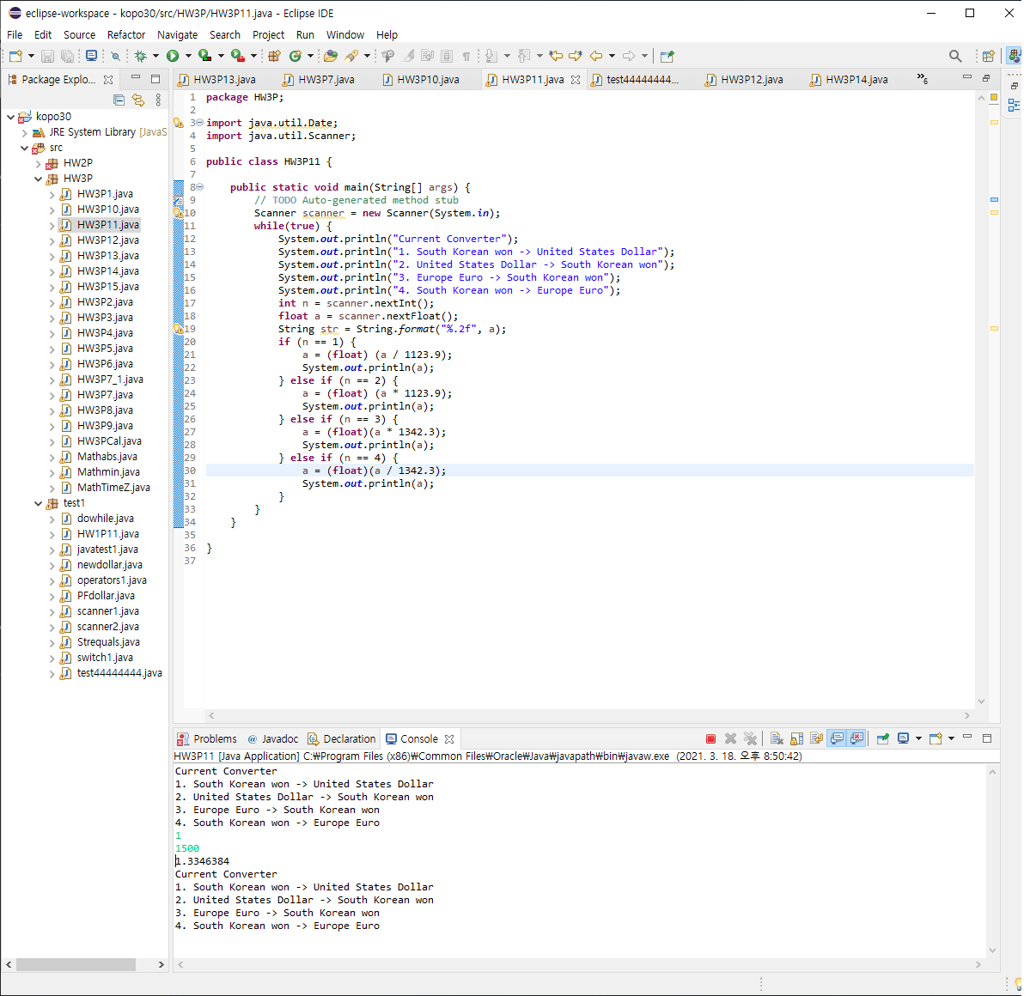
P11 : Currency Converter

Slide 15
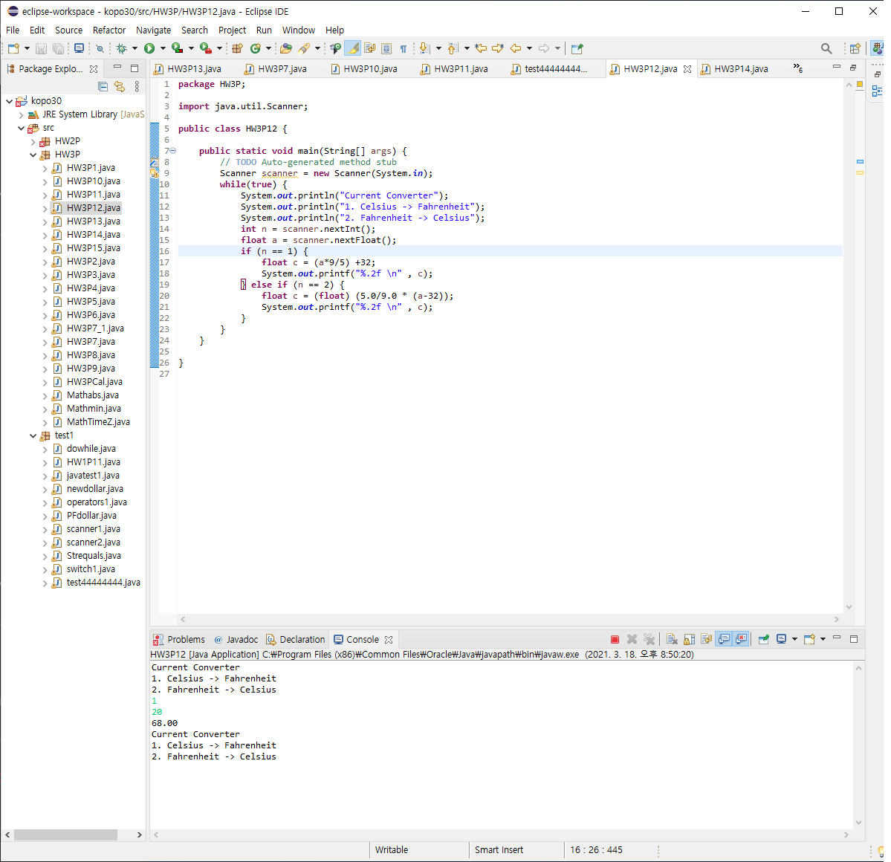
P12 : Temperature Converter

Slide 16
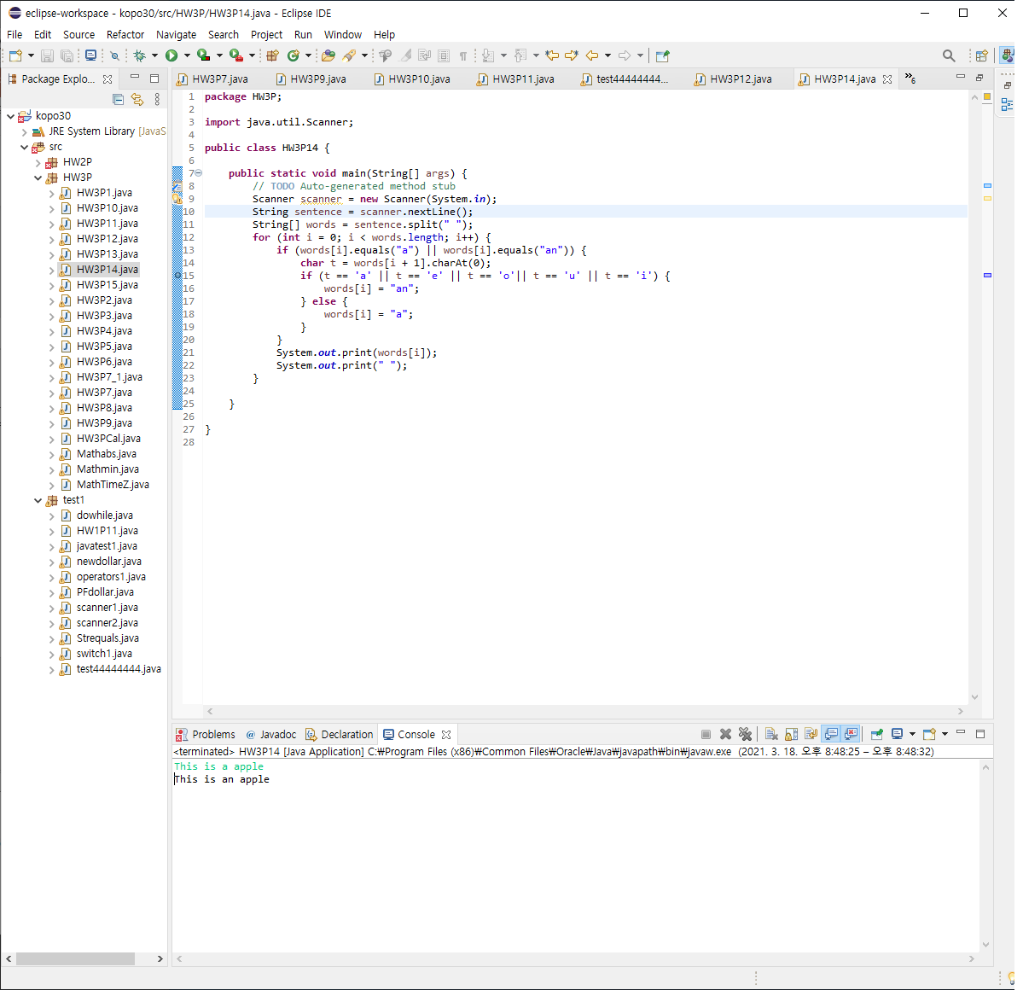
P14 : Article before Consonant and Vowel

Slide 17
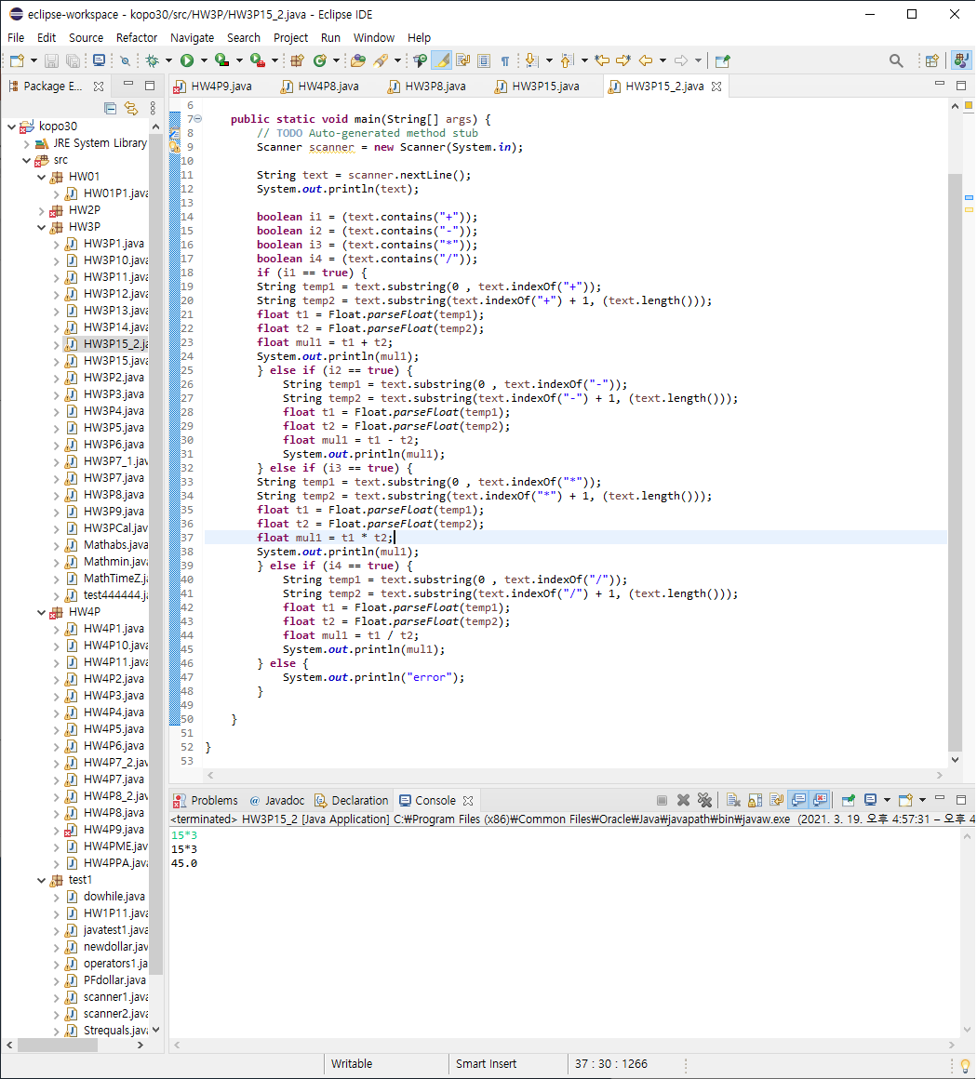
P15 : Calculator

Slide 18
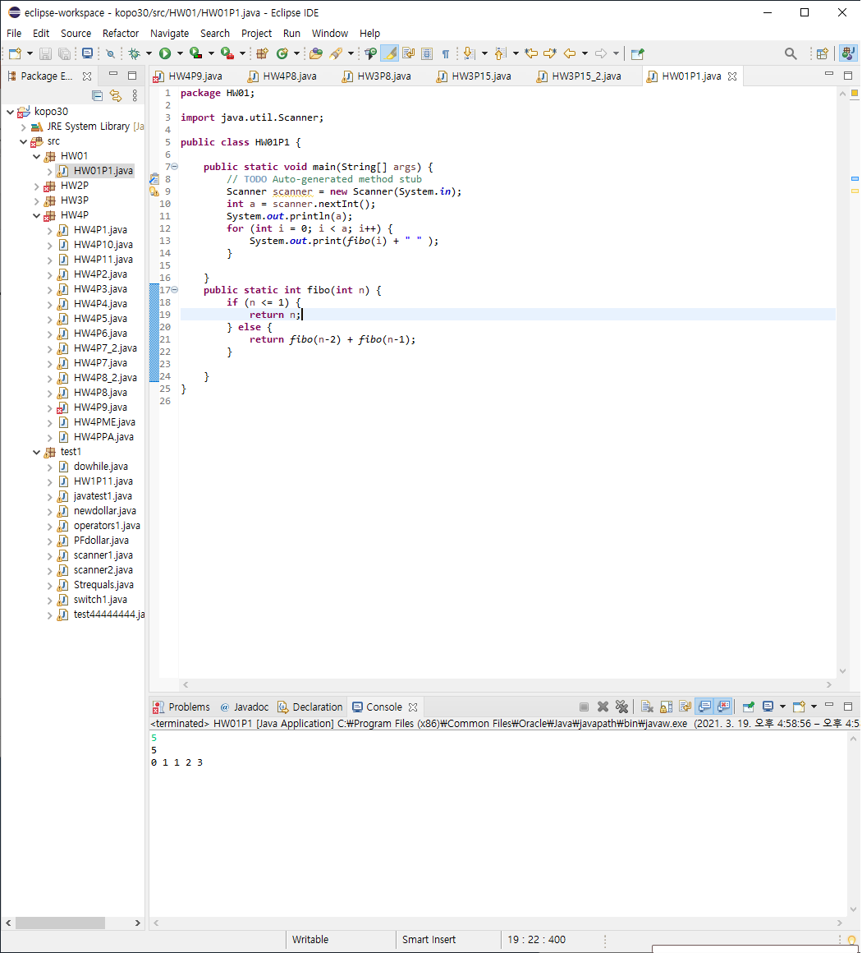
HW01-P1 : Fibonacci Number
음수가 나오면 오류처리

Slide 19
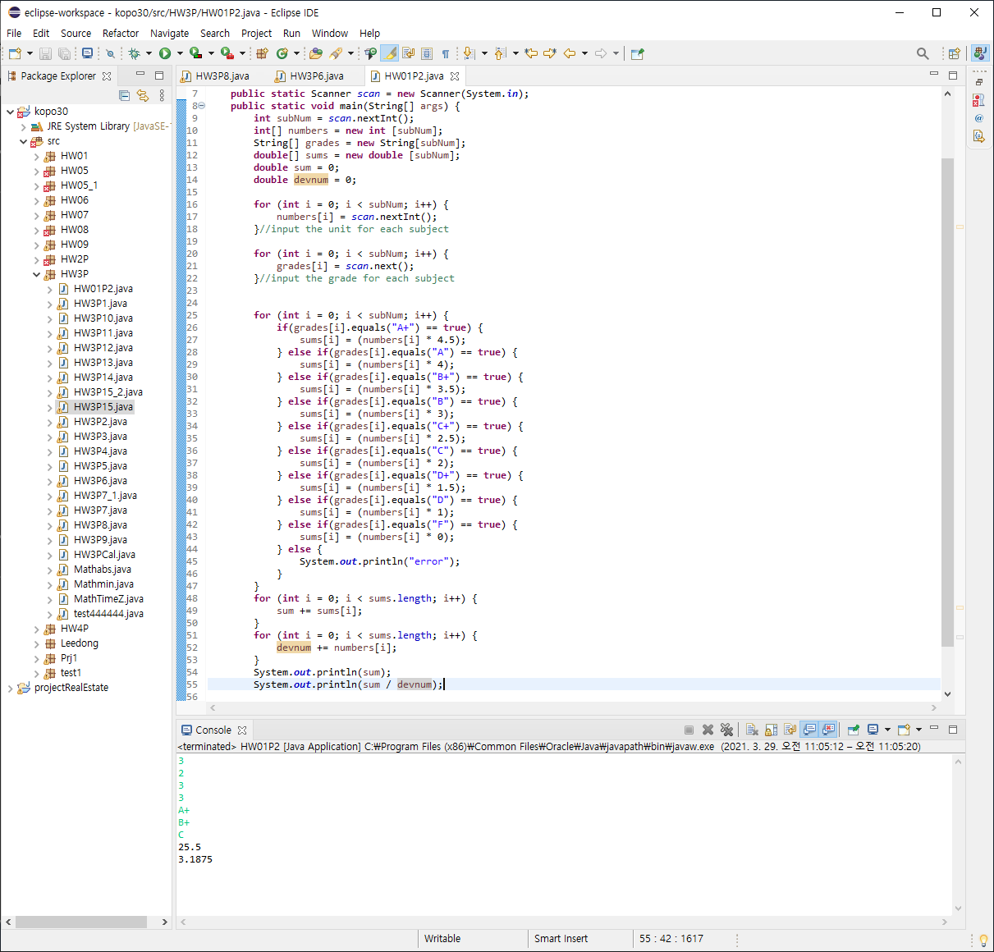
HW01-P2 : Grade Calculator

